Slide 1










STUDENT MANAGEMENT SYSTEM
Name : K.Aishwarya Batch No : 2022-7601
Enrollment Number :EBEON1022118116

Slide 2






Contents
Introduction to Student Management System Frontend : Thyme leaf,HTML , Bootstrap Backend : Spring Boot ,Maven
Technologies used Objective Requirements Screenshots’ Page1 :Home
Page 2:Course creation Page3:Student Registration
Advantages Conclusion
➢
➢
➢
➢
➢
➢
➢
➢
➢
➢
➢
➢

Slide 3





Introduction to Student Management
◆
The system will use to manage the student management
The student management System consists of Course creation and Student registration
The System can handle all the details about a student
The Student Management System is an automated version of manual Student Management System
◆
◆
◆

Slide 4



Frontend : Thyme leaf
◆
Thymeleaf is a modern server-side J ava template engine for both web and standalone environments, capable of processing HTML, XML, J avaScript, CSS and even plain text.
The main goal of Thymeleaf is to provide an elegant and highly-maintainable way of creating templates. To achieve this, it builds on the concept of Natural Template s to inject its logic into template files in a way that doesn’t affect the template from being used as a design prototype. This improves communication of design and bridges the gap between design and development teams.
Thymeleaf has also been designed from the beginning with Web Standards in mind – especial y HTML5 – al owing you to create ful y validating templates if that is a need for you.
◆
◆

Slide 5


Thymeleaf Attributes
1. Thymeleaf th:text attribute
2. Thymeleaf th:each attribute
3. Thymeleaf th:if and th:unless attribute
4. Thymeleaf th:switch and th:case attribute
5. Thymeleaf th:fragment attribute

Slide 6


Backend : Spring Boot
◆
Creating Spring boot using boot initializer
Spring Boot automatically configures your application based on the dependencies you have added to the project
Dependencies that added in my project are :
◆
◆
Spring web
Thyme lea
Spring Data JPA
MySql database
Devtools

Slide 7


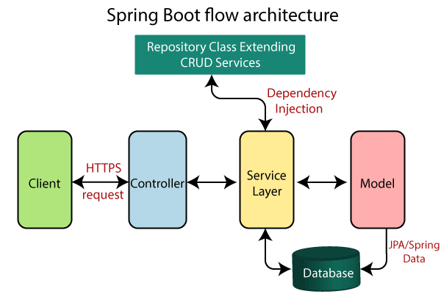
Spring Boot Architecture

Slide 8


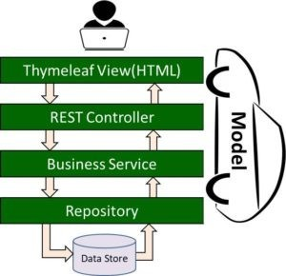
Thyme leaf And Spring Boot Architecture

Slide 9


Spring Boot
◆
Spring Boot is a popular backend technology, based on JavaScript. It can be utilized effectively by any Java app with the availability of multiple extensions for development. There are multiple modules that give services. There is a spring core container that is a primary module offering containers. It is written in Java and is open source in nature. Spring Boot maintains a list of standards and tools that help garner good results.
Key Features:
Uses the Spring security sub-project to offer security Leverages the Spring platform
Written in Java
It Helps developers start off with ease Focuses on enterprise applications
◆
•
•
•
•
•

Slide 10


MY SQL
➢
The most popular open-source database in the world is mySQL. It is very powerful and simple to set up, and easy to use.
Once we have done the setup and are ready to use, we can connect with the client as a superuser.
In the shell, we need to give this command to connect with the root(superuser) MySQL -u root –p.
We can perform many different operations using mySQL like create, delete a database, insert a record; all this is possible using simple commands.
➢
➢
➢

Slide 11


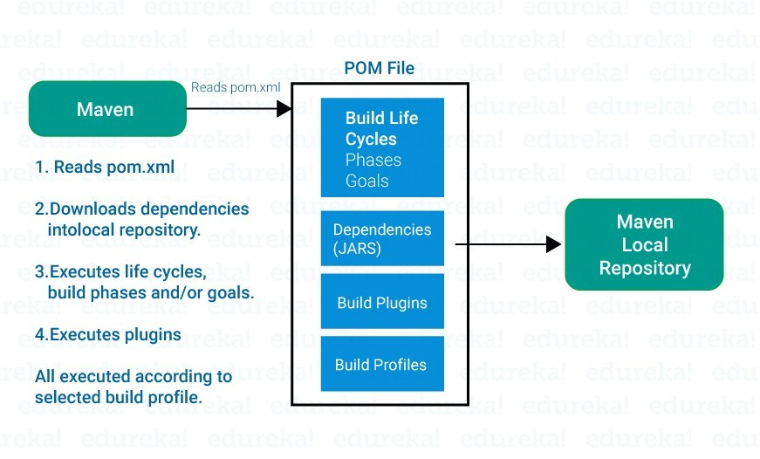
Backend : Maven
◆
Maven is a really strong project management tool that is used to build and manage any Java-related project. Maven helps in easing the job of a Java developer. It is capable of handling a project’s build, reporting, and documentation.
After understanding the meaning of Maven in Java, let me show you the working through the help of a diagram.
◆

Slide 12


Technologies And Tools
◆
Thmye leaf Bootstrap Maven
My Sql Spring Boot
◆
◆
◆
◆

Slide 13


Objectives
) The main objective of the Student Management System provides an online
platform to manage the students of a college and
coaching institutes
) Improves The General Comfort Of Staffs
3) Provide A Means To Advice Students

Slide 14


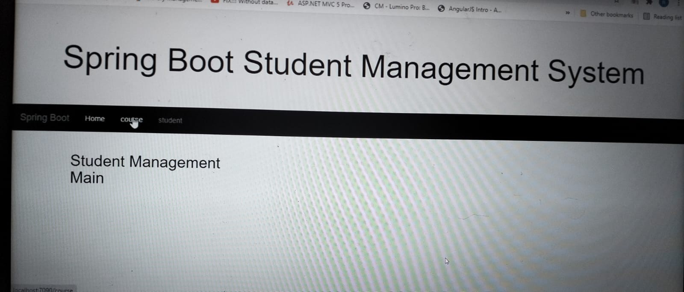
Home page

Slide 15


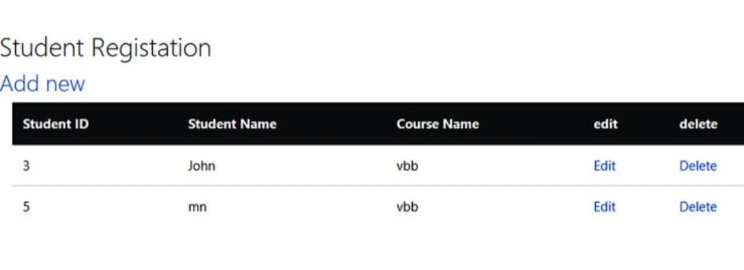
Student registration

Slide 16


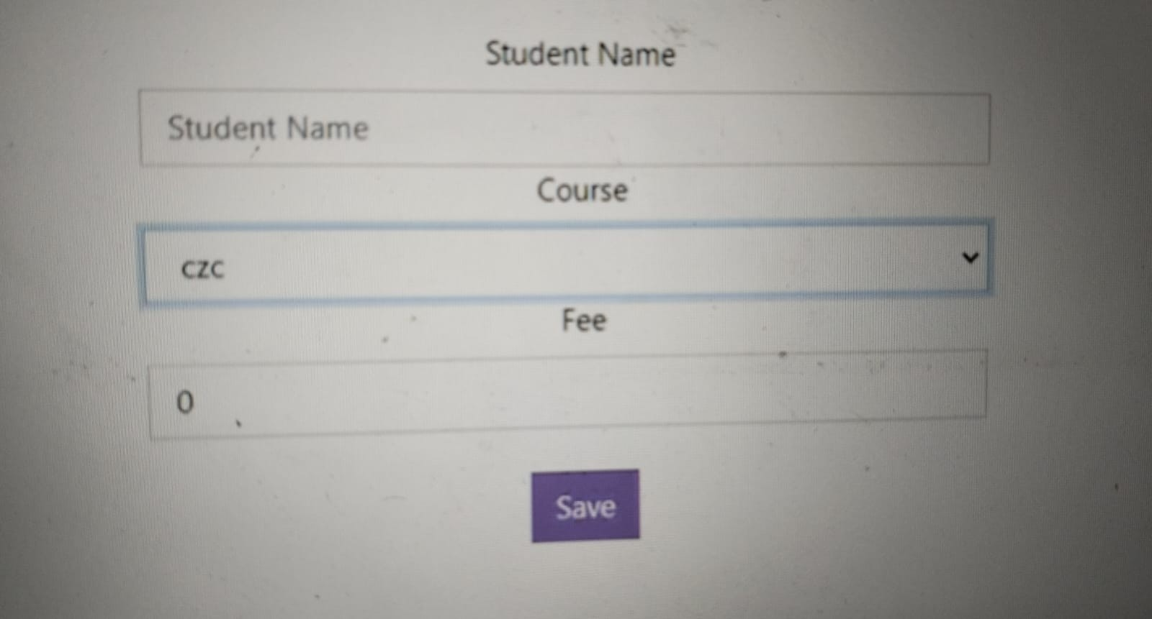
Add new student

Slide 17


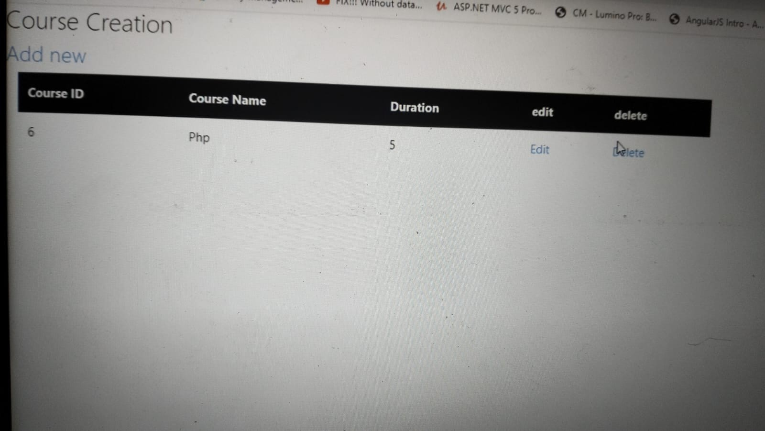
Course creation

Slide 18


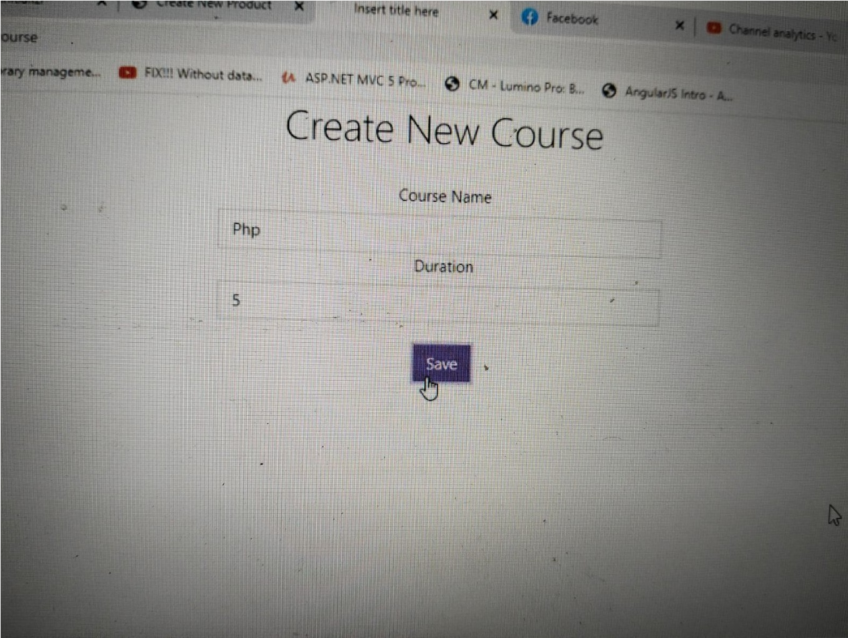
Add new course

Slide 19


Advantages
The student management system work across the whole student lifecycle Keeping management of student data and managing knowledge has ne’er been therefore easy!
The complete pursuit of the scholars.
Managing the timetables.
Easy access to all or any. 5)Better communication.
6) Simplifying and streamlining all the tasks.
●

Slide 20


Conclusion
Helpful to perform paperless work and manage all data
Provide easy ,accurate, unambigious and faster data access
Student management systems provide effective mechanisms for higher education institutions to manage students and faculty and their interaction with each other and external systems
User friendly screen to access data Help to access the record
Show quoted text

